Slide 1

Slides developed by Mine Çetinkaya-Rundel of OpenIntro
Translated from LaTeX to Google Slides by Curry W. Hilton of OpenIntro.
The slides may be copied, edited, and/or shared via the CC BY-SA license
To make a copy of these slides, go to File > Download as > [option], as shown below. Or if you are logged into a Google account, you can choose Make a copy... to create your own version in Google Drive.

Slide 2
Normal distribution

Slide 3
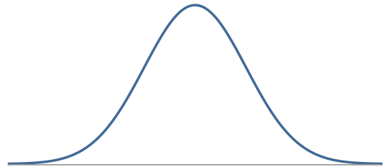
Normal Distribution
Unimodal and symmetric, bell shaped curve
Many variables are nearly normal, but none are exactly normal
Denoted as N(µ, σ) → Normal with mean µ and standard deviation σ

Slide 4
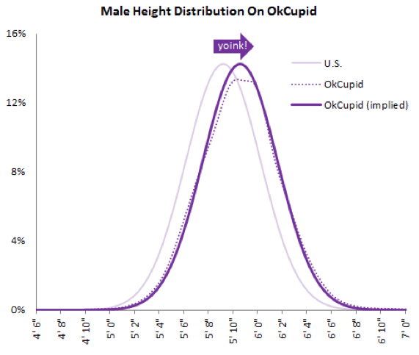
Heights of males

Slide 5
Heights of males
“The male heights on OkCupid very nearly follow the expected normal distribution -- except the whole thing is shifted to the right of where it should be. Almost universally guys like to add a couple inches.”
“You can also see a more subtle vanity at work: starting at roughly 5' 8", the top of the dotted curve tilts even further rightward. This means that guys as they get closer to six feet round up a bit more than usual, stretching for that coveted psychological benchmark.”
http://blog.okcupid.com/index.php/the-biggest-lies-in-online-dating

Slide 6
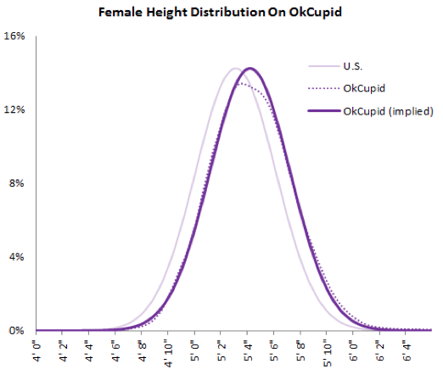
Heights of females

Slide 7
Heights of females
“When we looked into the data for women, we were surprised to see height exaggeration was just as widespread, though without the lurch towards a benchmark height.”
http://blog.okcupid.com/index.php/the-biggest-lies-in-online-dating

Slide 8
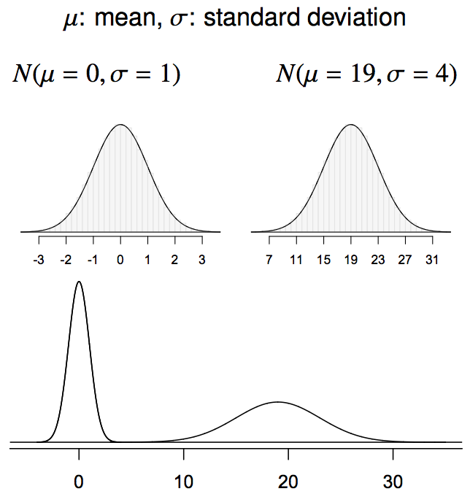
Normal distributions with different parameters

Slide 9
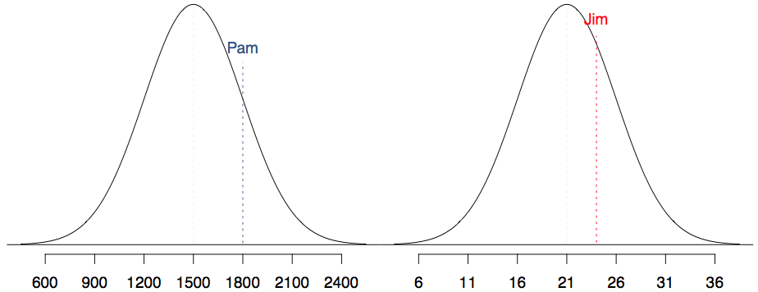
SAT scores are distributed nearly normally with mean 1500 and standard deviation 300. ACT scores are distributed nearly normally with mean 21 and standard deviation 5. A college admissions officer wants to determine which of the two applicants scored better on their standardized test with respect to the other test takers: Pam, who earned an 1800 on her SAT, or Jim, who scored a 24 on his ACT?

Slide 10
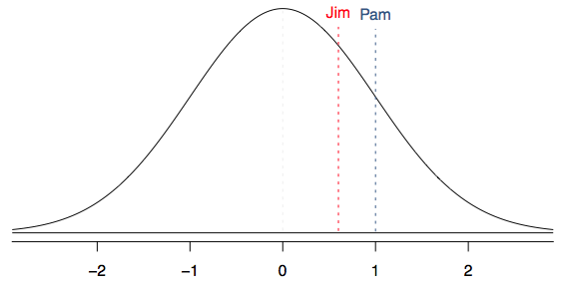
Standardizing with Z scores
Since we cannot just compare these two raw scores, we instead compare how many standard deviations beyond the mean each observation is.
Pam's score is (1800 - 1500) / 300 = 1 standard deviation above the mean.
Jim's score is (24 - 21) / 5 = 0.6 standard deviations above the mean.

Slide 11
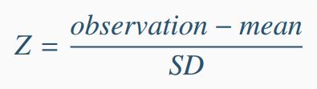
Standardizing with Z scores (cont.)
These are called standardized scores, or Z scores.
Z score of an observation is the number of standard deviations it falls above or below the mean.
Z scores are defined for distributions of any shape, but only when the distribution is normal can we use Z scores to calculate percentiles.
Observations that are more than 2 SD away from the mean (|Z| > 2) are usually considered unusual.

Slide 12
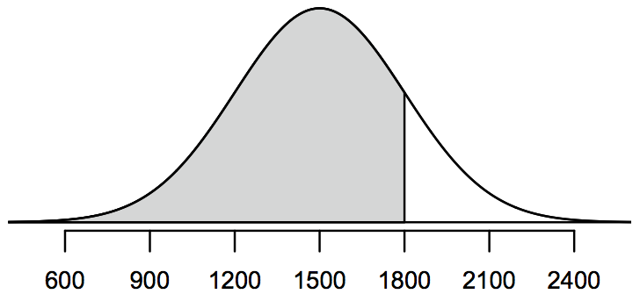
Percentiles
Percentile is the percentage of observations that fall below a given data point.
Graphically, percentile is the area below the probability distribution curve to the left of that observation.

Slide 13
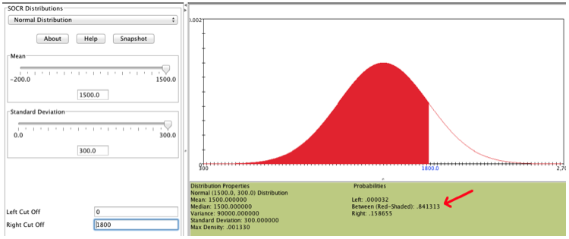
Calculating percentiles -
using computation
There are many ways to compute percentiles/areas under the curve. R:
Applet: www.socr.ucla.edu/htmls/SOCR_Distributions.html

Slide 14
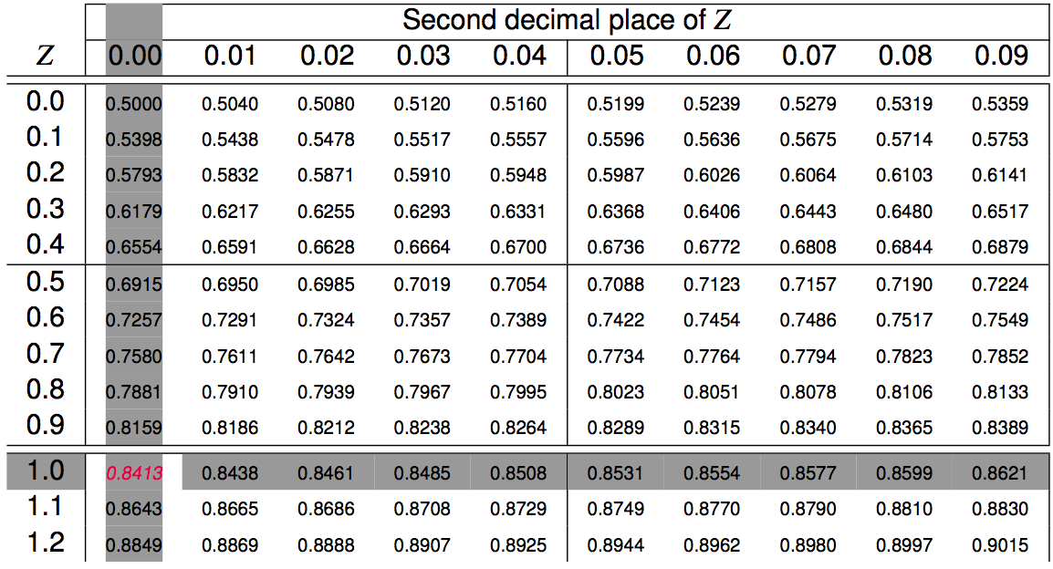
Calculating percentiles -
using tables

Slide 15
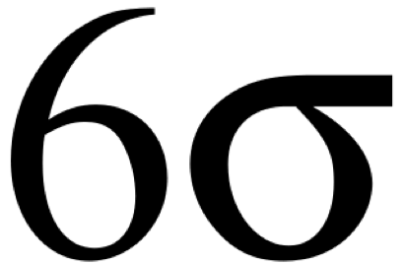
Six sigma
The term six sigma process comes from the notion that if one has six standard deviations between the process mean and the nearest specification limit, as shown in the graph, practically no items will fail to meet specifications.
http://en.wikipedia.org/wiki/Six_Sigma

Slide 16
Quality control
At Heinz ketchup factory the amounts which go into bottles of ketchup are supposed to be normally distributed with mean 36 oz. and standard deviation 0.11 oz. Once every 30 minutes a bottle is selected from the production line, and its contents are noted precisely. If the amount of ketchup in the bottle is below 35.8 oz. or above 36.2 oz., then the bottle fails the quality control inspection. What percent of bottles have less than 35.8 ounces of ketchup?

Slide 17
Quality control
At Heinz ketchup factory the amounts which go into bottles of ketchup are supposed to be normally distributed with mean 36 oz. and standard deviation 0.11 oz. Once every 30 minutes a bottle is selected from the production line, and its contents are noted precisely. If the amount of ketchup in the bottle is below 35.8 oz. or above 36.2 oz., then the bottle fails the quality control inspection. What percent of bottles have less than 35.8 ounces of ketchup?
Let X = amount of ketchup in a bottle: X ~ N(µ = 36, σ = 0.11)

Slide 18
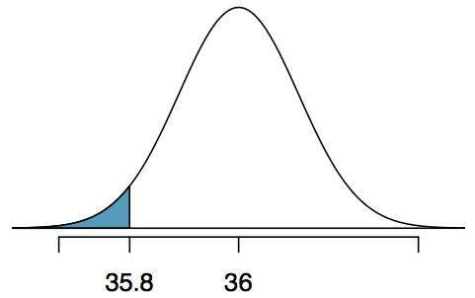
Quality control
At Heinz ketchup factory the amounts which go into bottles of ketchup are supposed to be normally distributed with mean 36 oz. and standard deviation 0.11 oz. Once every 30 minutes a bottle is selected from the production line, and its contents are noted precisely. If the amount of ketchup in the bottle is below 35.8 oz. or above 36.2 oz., then the bottle fails the quality control inspection. What percent of bottles have less than 35.8 ounces of ketchup?
Let X = amount of ketchup in a bottle: X ~ N(µ = 36, σ = 0.11)

Slide 19
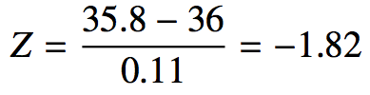
Quality control
At Heinz ketchup factory the amounts which go into bottles of ketchup are supposed to be normally distributed with mean 36 oz. and standard deviation 0.11 oz. Once every 30 minutes a bottle is selected from the production line, and its contents are noted precisely. If the amount of ketchup in the bottle is below 35.8 oz. or above 36.2 oz., then the bottle fails the quality control inspection. What percent of bottles have less than 35.8 ounces of ketchup?
Let X = amount of ketchup in a bottle: X ~ N(µ = 36, σ = 0.11)

Slide 20
Finding the exact probability - using R
> pnorm(-1.82, mean = 0, sd = 1)
[1] 0.0344
OR
> pnorm(35.8, mean = 36, sd = 0.11)
[1] 0.0345

Slide 21
Practice
What percent of bottles pass the quality control inspection?
(a) 1.82% (c) 6.88% (e) 96.56%
(b) 3.44% (d) 93.12%

Slide 22
Practice
What percent of bottles pass the quality control inspection?
(a) 1.82% (c) 6.88% (e) 96.56%
(b) 3.44% (d) 93.12%

Slide 23
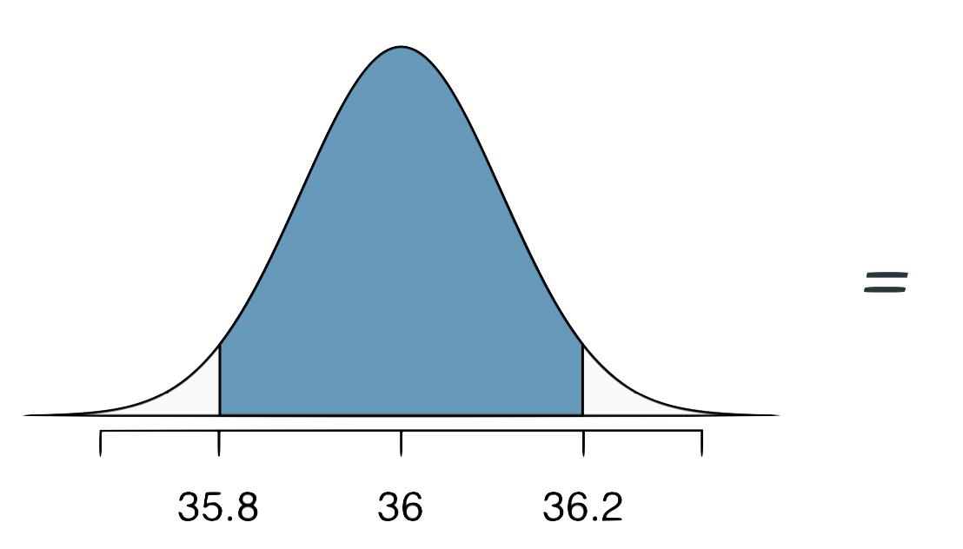
Practice
What percent of bottles pass the quality control inspection?
(a) 1.82% (c) 6.88% (e) 96.56%
(b) 3.44% (d) 93.12%

Slide 24
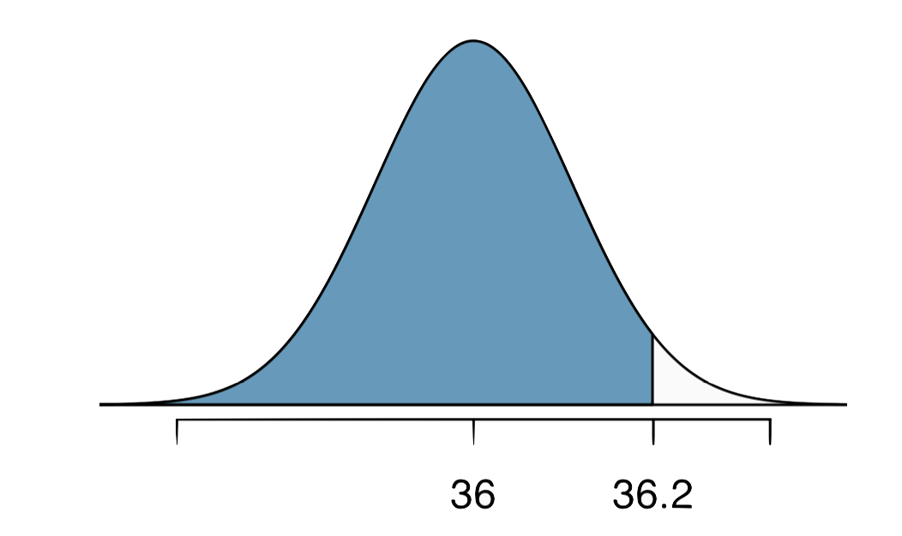
Practice
What percent of bottles pass the quality control inspection?
(a) 1.82% (c) 6.88% (e) 96.56%
(b) 3.44% (d) 93.12%

Slide 25
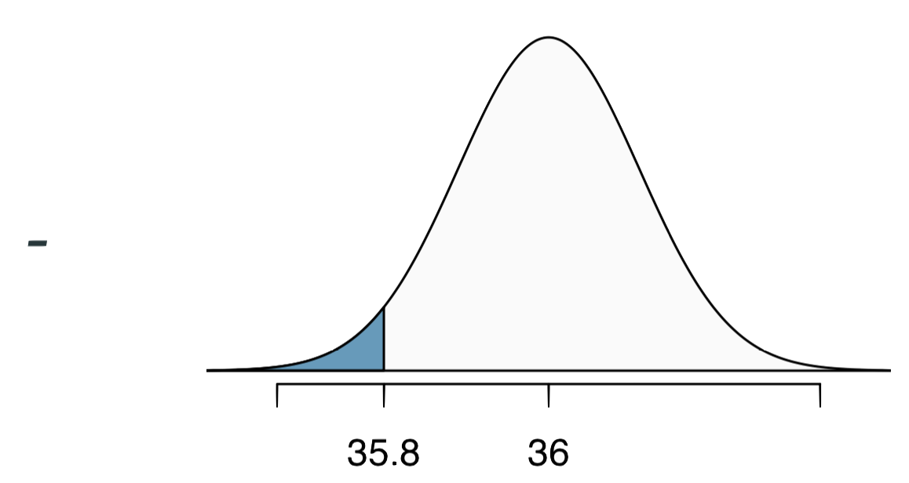
Practice
What percent of bottles pass the quality control inspection?
(a) 1.82% (c) 6.88% (e) 96.56%
(b) 3.44% (d) 93.12%

Slide 26
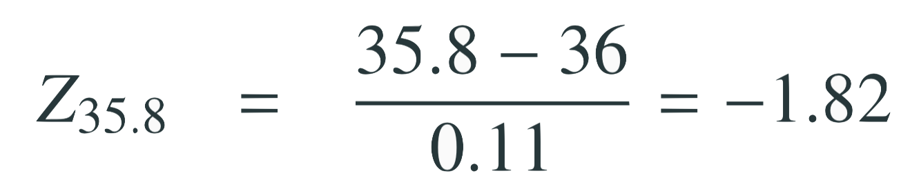
Practice
What percent of bottles pass the quality control inspection?
(a) 1.82% (c) 6.88% (e) 96.56%
(b) 3.44% (d) 93.12%

Slide 27
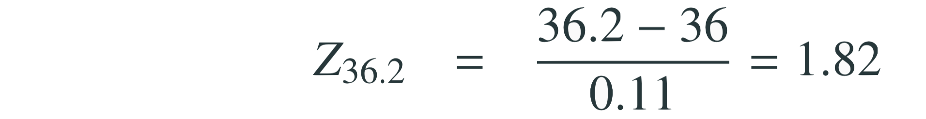
Practice
What percent of bottles pass the quality control inspection?
(a) 1.82% (c) 6.88% (e) 96.56%
(b) 3.44% (d) 93.12%

Slide 28
Practice
What percent of bottles pass the quality control inspection?
(a) 1.82% (c) 6.88% (e) 96.56%
(b) 3.44% (d) 93.12%

Slide 29
Finding cutoff points
Body temperatures of healthy humans are distributed nearly normally with mean 98.2ºF and standard deviation 0.73ºF. What is the cutoff for the lowest 3% of human body temperatures?

Slide 30
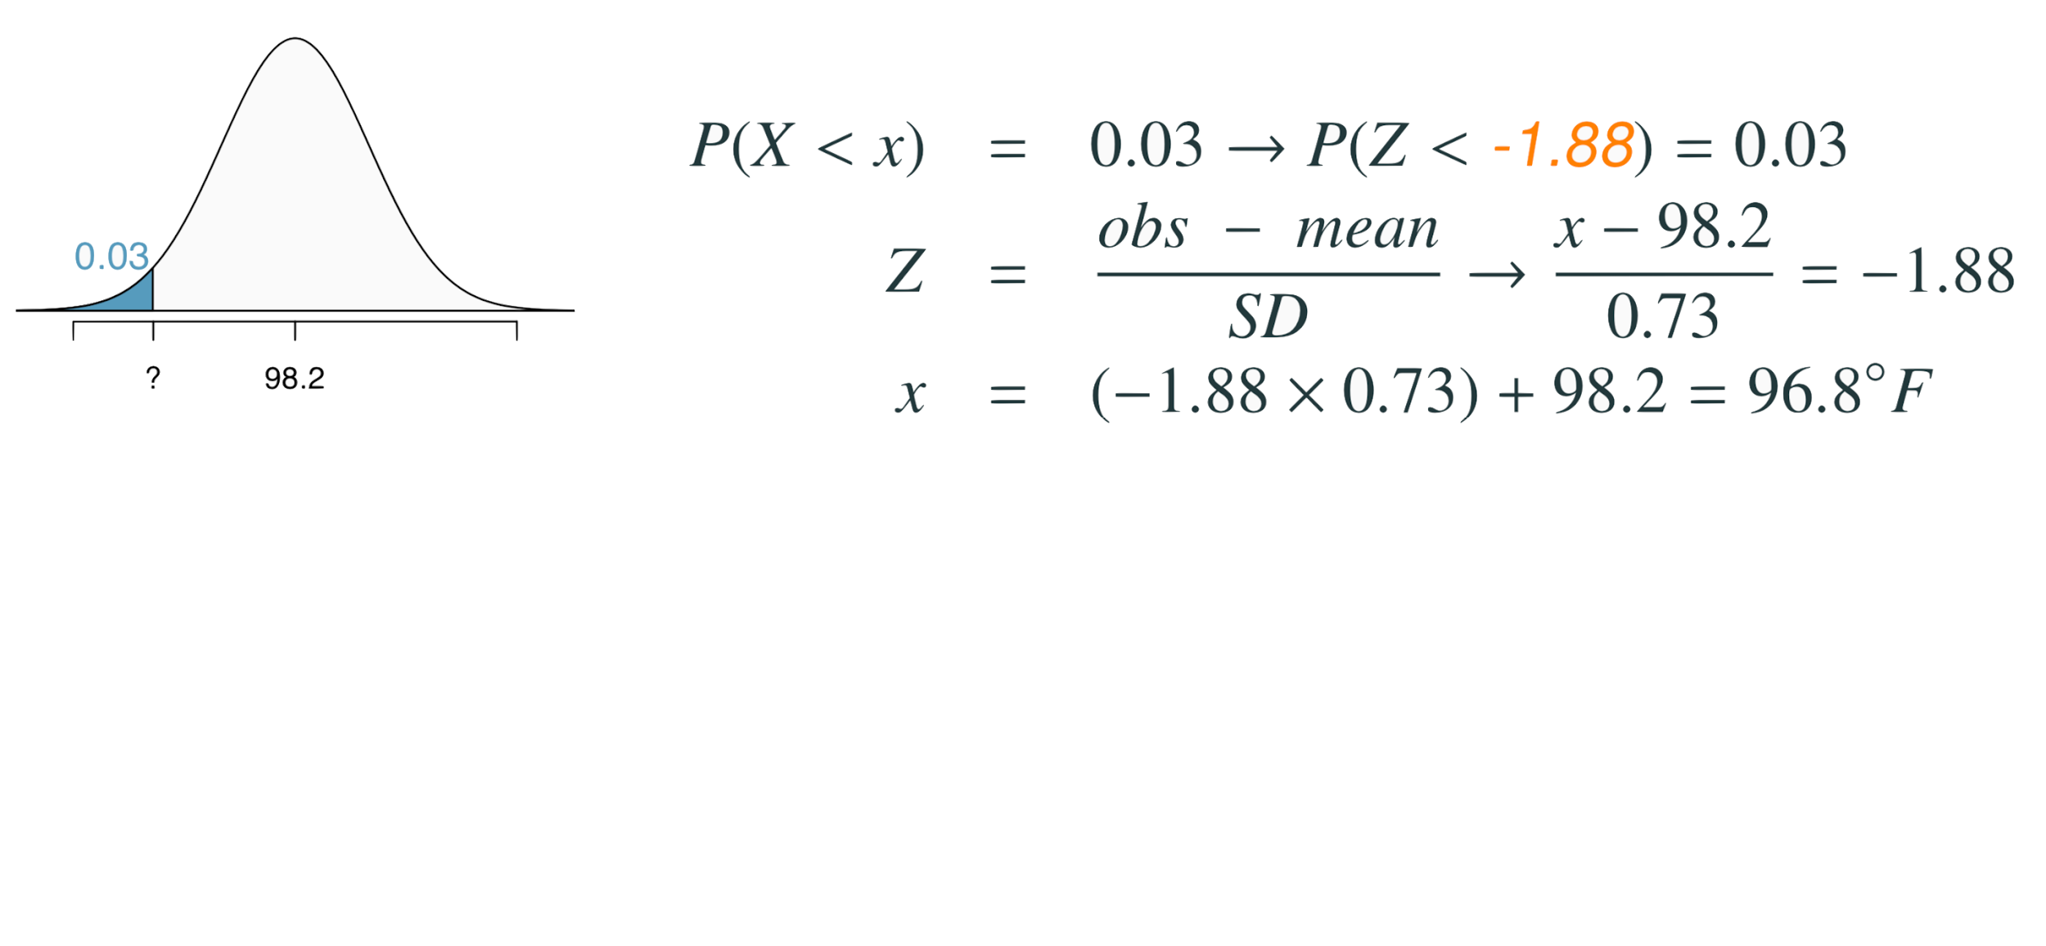
Finding cutoff points
Body temperatures of healthy humans are distributed nearly normally with mean 98.2ºF and standard deviation 0.73ºF. What is the cutoff for the lowest 3% of human body temperatures?

Slide 31
Finding cutoff points
Body temperatures of healthy humans are distributed nearly normally with mean 98.2ºF and standard deviation 0.73ºF. What is the cutoff for the lowest 3% of human body temperatures?

Slide 32
Finding cutoff points
Body temperatures of healthy humans are distributed nearly normally with mean 98.2ºF and standard deviation 0.73ºF. What is the cutoff for the lowest 3% of human body temperatures?

Slide 33
Finding cutoff points
Body temperatures of healthy humans are distributed nearly normally with mean 98.2ºF and standard deviation 0.73ºF. What is the cutoff for the lowest 3% of human body temperatures?

Slide 34
Finding cutoff points
Body temperatures of healthy humans are distributed nearly normally with mean 98.2ºF and standard deviation 0.73ºF. What is the cutoff for the lowest 3% of human body temperatures?
> qnorm(0.03)
[1] -1.880794
Mackowiak, Wasserman, and Levine (1992), A Critical Appraisal of 98.6 Degrees F, the Upper Limit of the Normal Body Temperature, and Other Legacies of Carl Reinhold August Wunderlick.

Slide 35
Practice
Body temperatures of healthy humans are distributed nearly nor- mally with mean 98.2ºF and standard deviation 0.73ºF. What is the cutoff for the highest 10% of human body temperatures?
(a) 97.3ºF (c) 99.4ºF
(b) 99.1ºF (d) 99.6ºF

Slide 36
Practice
Body temperatures of healthy humans are distributed nearly nor- mally with mean 98.2ºF and standard deviation 0.73ºF. What is the cutoff for the highest 10% of human body temperatures?
(a) 97.3ºF (c) 99.4ºF
(b) 99.1ºF (d) 99.6ºF

Slide 37
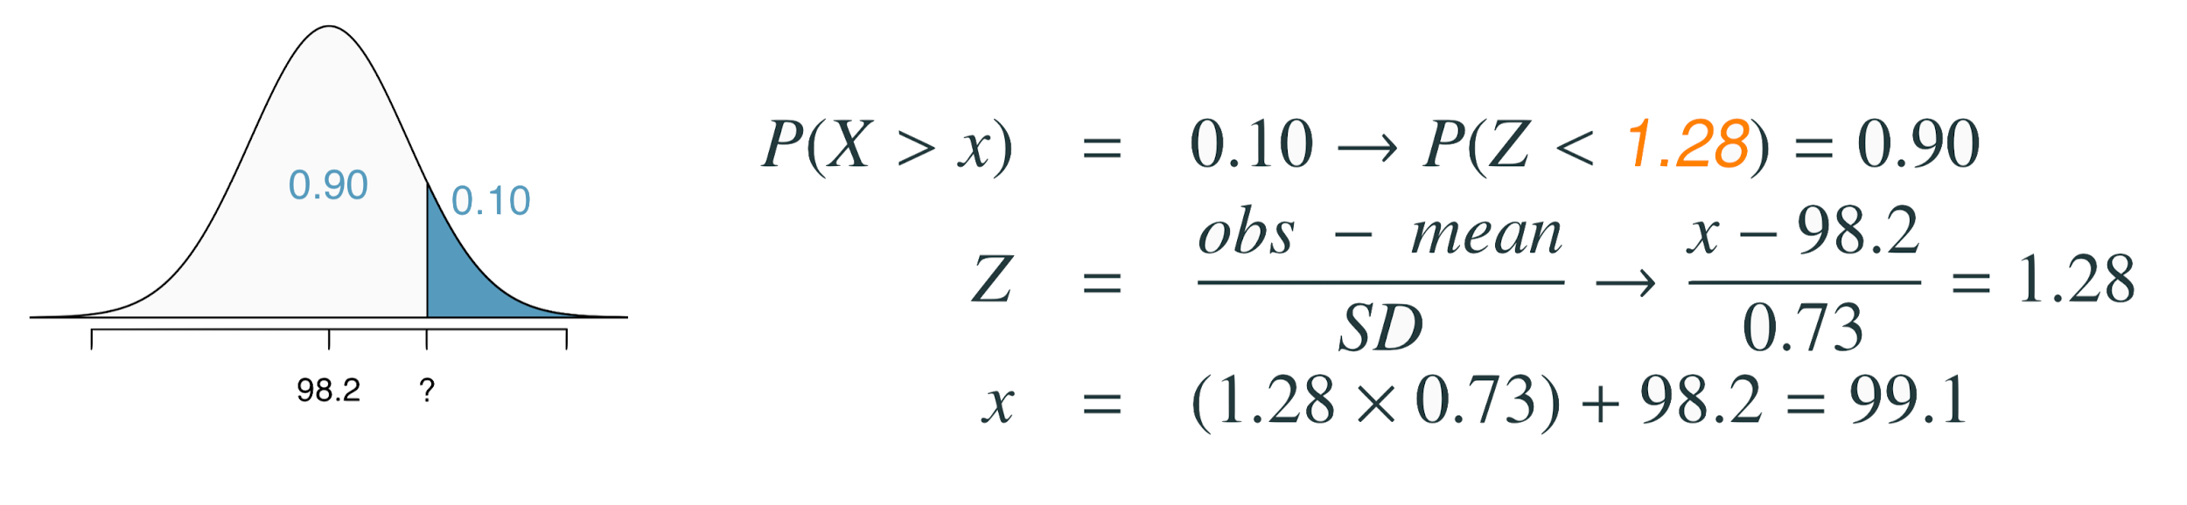
Practice
Body temperatures of healthy humans are distributed nearly nor- mally with mean 98.2ºF and standard deviation 0.73ºF. What is the cutoff for the highest 10% of human body temperatures?
(a) 97.3ºF (c) 99.4ºF
(b) 99.1ºF (d) 99.6ºF

Slide 38
Practice
Body temperatures of healthy humans are distributed nearly nor- mally with mean 98.2ºF and standard deviation 0.73ºF. What is the cutoff for the highest 10% of human body temperatures?
(a) 97.3ºF (c) 99.4ºF
(b) 99.1ºF (d) 99.6ºF

Slide 39
Practice
Body temperatures of healthy humans are distributed nearly nor- mally with mean 98.2ºF and standard deviation 0.73ºF. What is the cutoff for the highest 10% of human body temperatures?
(a) 97.3ºF (c) 99.4ºF
(b) 99.1ºF (d) 99.6ºF

Slide 40
Practice
Body temperatures of healthy humans are distributed nearly nor- mally with mean 98.2ºF and standard deviation 0.73ºF. What is the cutoff for the highest 10% of human body temperatures?
(a) 97.3ºF (c) 99.4ºF
(b) 99.1ºF (d) 99.6ºF

Slide 41
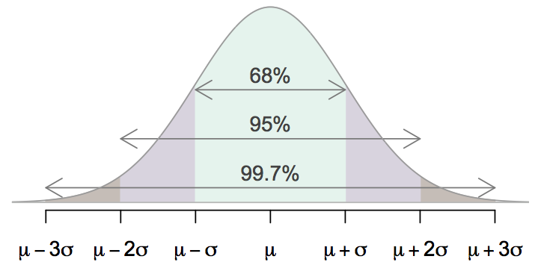
68-95-99.7 Rule
For nearly normally distributed data,
about 68% falls within 1 SD of the mean,
about 95% falls within 2 SD of the mean,
about 99.7% falls within 3 SD of the mean.
It is possible for observations to fall 4, 5, or more standard deviations away from the mean, but these occurrences are very rare if the data are nearly normal.

Slide 42
Describing variability using the 68-95-99.7 Rule
SAT scores are distributed nearly normally with mean 1500 and standard deviation 300.

Slide 43
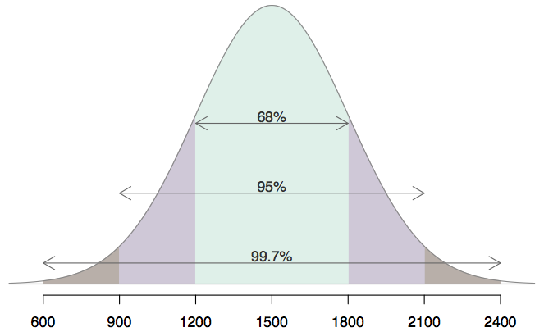
Describing variability using the 68-95-99.7 Rule
SAT scores are distributed nearly normally with mean 1500 and standard deviation 300.
~68% of students score between 1200 and 1800 on the SAT.
~95% of students score between 900 and 2100 on the SAT.
~$99.7% of students score between 600 and 2400 on the SAT.

Slide 44
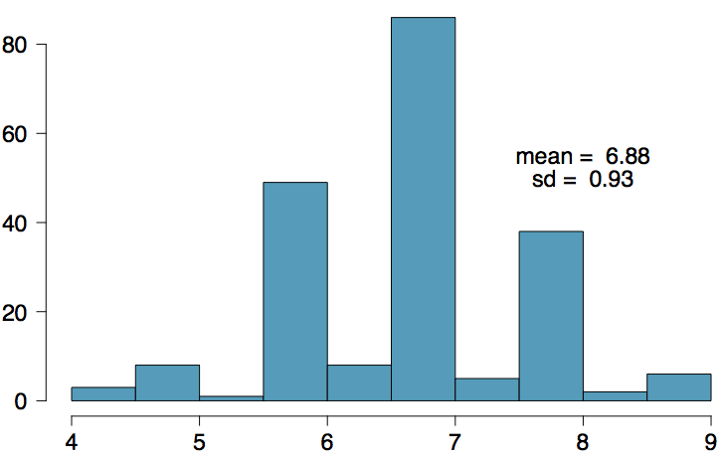
Number of hours of sleep on school nights
Mean = 6.88 hours, SD = 0.92 hrs

Slide 45
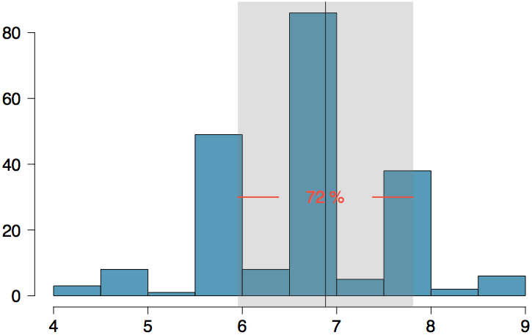
Number of hours of sleep on school nights
Mean = 6.88 hours, SD = 0.92 hrs
72% of the data are within 1 SD of the mean: 6.88 ± 0.93

Slide 46
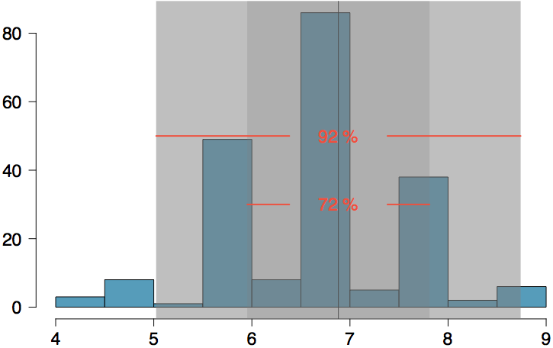
Number of hours of sleep on school nights
Mean = 6.88 hours, SD = 0.92 hrs
72% of the data are within 1 SD of the mean: 6.88 ± 0.93
92% of the data are within 1 SD of the mean: 6.88 ± 2 x 0.93

Slide 47
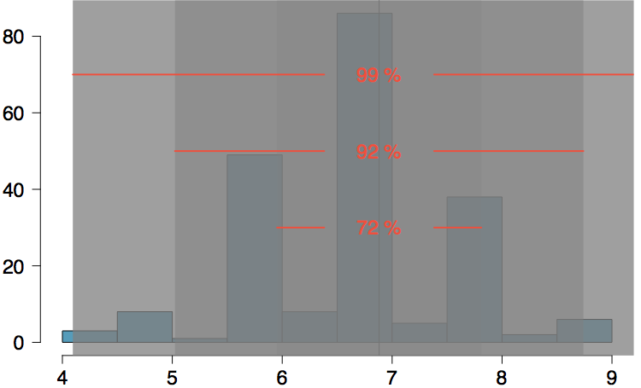
Number of hours of sleep on school nights
Mean = 6.88 hours, SD = 0.92 hrs
72% of the data are within 1 SD of the mean: 6.88 ± 0.93
92% of the data are within 1 SD of the mean: 6.88 ± 2 x 0.93
99% of the data are within 1 SD of the mean: 6.88 ± 3 x 0.93

Slide 48
Practice
Which of the following is false?
Majority of Z scores in a right skewed distribution are negative.
In skewed distributions the Z score of the mean might be different than 0.
For a normal distribution, IQR is less than 2 x SD.
Z scores are helpful for determining how unusual a data point is compared to the rest of the data in the distribution.

Slide 49
Practice
Which of the following is false?
Majority of Z scores in a right skewed distribution are negative.
In skewed distributions the Z score of the mean might be different than 0.
For a normal distribution, IQR is less than 2 x SD.
Z scores are helpful for determining how unusual a data point is compared to the rest of the data in the distribution.

Slide 50
Find more resources at openintro.org/os, including
Slides
Videos
Statistical Software Labs
Discussion Forums (free support for students and teachers)
Learning Objectives
Teachers only content is also available for Verified Teachers, including
Exercise solutions
Sample exams
Ability to request a free desk copy for a course
Statistics Teachers email group
Questions? Contact us.

Slide 51
Appendix
Probability Tables

Slide 52
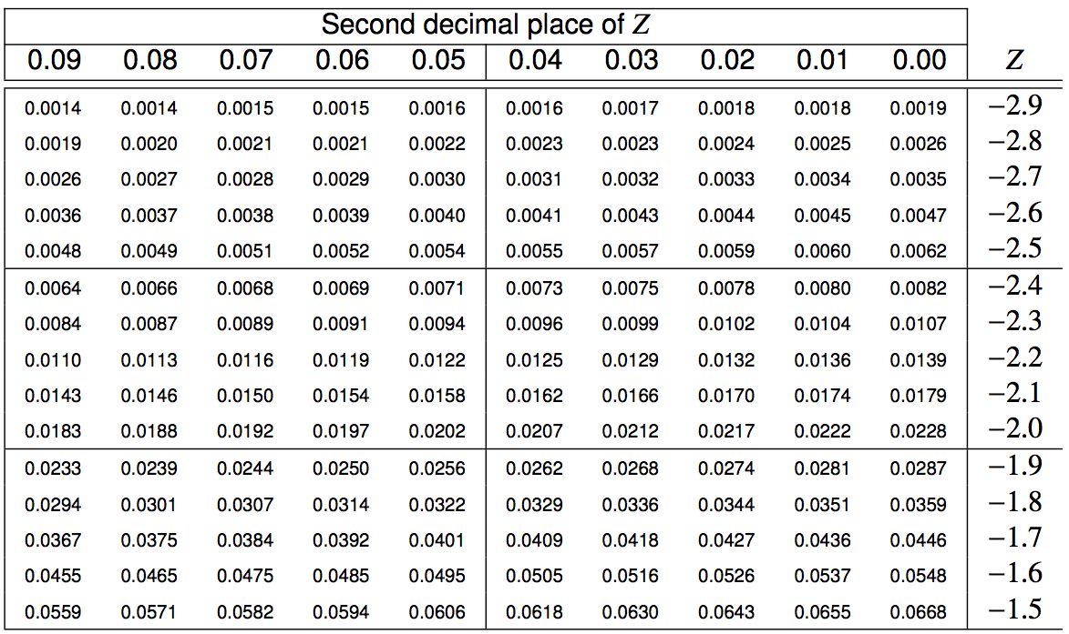
Finding the exact probability - using the Z table

Slide 53
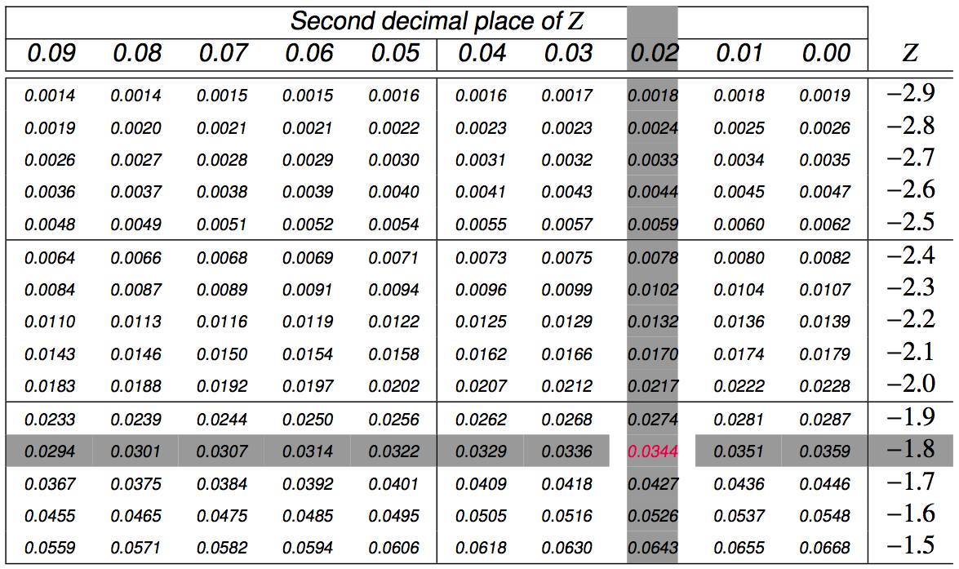
Finding the exact probability - using the Z table

Slide 54
Finding cutoff points
Body temperatures of healthy humans are distributed nearly normally with mean 98.2ºF and standard deviation 0.73ºF. What is the cutoff for the lowest 3% of human body temperatures?

Slide 55
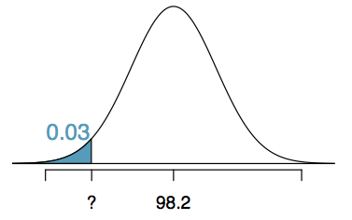
Finding cutoff points
Body temperatures of healthy humans are distributed nearly normally with mean 98.2ºF and standard deviation 0.73ºF. What is the cutoff for the lowest 3% of human body temperatures?

Slide 56
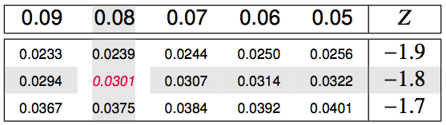
Finding cutoff points
Body temperatures of healthy humans are distributed nearly normally with mean 98.2ºF and standard deviation 0.73ºF. What is the cutoff for the lowest 3% of human body temperatures?

Slide 57
Finding cutoff points
Body temperatures of healthy humans are distributed nearly normally with mean 98.2ºF and standard deviation 0.73ºF. What is the cutoff for the lowest 3% of human body temperatures?

Slide 58

Finding cutoff points
Body temperatures of healthy humans are distributed nearly normally with mean 98.2ºF and standard deviation 0.73ºF. What is the cutoff for the lowest 3% of human body temperatures?

Slide 59
Finding cutoff points
Body temperatures of healthy humans are distributed nearly normally with mean 98.2ºF and standard deviation 0.73ºF. What is the cutoff for the lowest 3% of human body temperatures?
Mackowiak, Wasserman, and Levine (1992), A Critical Appraisal of 98.6 Degrees F, the Upper Limit of the Normal Body Temperature, and Other Legacies of Carl Reinhold August Wunderlick.

Slide 60
Practice
Body temperatures of healthy humans are distributed nearly normally with mean 98.2ºF and standard deviation 0.73ºF. What is the cutoff for the highest 10% of human body temperatures?
A. 97.3ºF C. 99.4ºF
B. 99.1ºF D. 99.6ºF

Slide 61
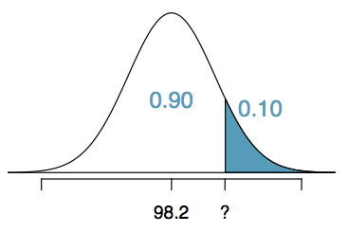
Practice
Body temperatures of healthy humans are distributed nearly normally with mean 98.2ºF and standard deviation 0.73ºF. What is the cutoff for the highest 10% of human body temperatures?
A. 97.3ºF C. 99.4ºF
B. 99.1ºF D. 99.6ºF

Slide 62
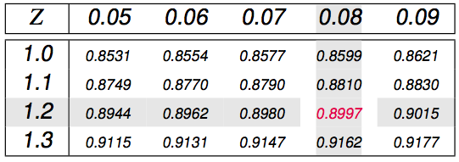
Practice
Body temperatures of healthy humans are distributed nearly normally with mean 98.2ºF and standard deviation 0.73ºF. What is the cutoff for the highest 10% of human body temperatures?
A. 97.3ºF C. 99.4ºF
B. 99.1ºF D. 99.6ºF

Slide 63
Practice
Body temperatures of healthy humans are distributed nearly normally with mean 98.2ºF and standard deviation 0.73ºF. What is the cutoff for the highest 10% of human body temperatures?
A. 97.3ºF C. 99.4ºF
B. 99.1ºF D. 99.6ºF

Slide 64

Practice
Body temperatures of healthy humans are distributed nearly normally with mean 98.2ºF and standard deviation 0.73ºF. What is the cutoff for the highest 10% of human body temperatures?
A. 97.3ºF C. 99.4ºF
B. 99.1ºF D. 99.6ºF

Slide 65
Practice
Body temperatures of healthy humans are distributed nearly normally with mean 98.2ºF and standard deviation 0.73ºF. What is the cutoff for the highest 10% of human body temperatures?
A. 97.3ºF C. 99.4ºF
B. 99.1ºF D. 99.6ºF

